Slide 1

IBM HR Analytics Employee Attrition & Performance

Slide 2
Contents
Introduction
Problem Statement
Tools (Libraries) used
Raw Data
Data Cleaning
Visualization
Data PreProcessing
Data Modelling
Conclusions

Slide 3
Introduction
Briefly introduce the topic of HR analytics and its significance in modern organizations.
Highlight the importance of understanding employee attrition and its impact on overall company performance.
Increased costs for recruiting and training new employees
Decreased productivity
Decline in morale and motivation among remaining employees
Damage to the organization's reputation

Slide 4
Problem Statement
High employee attrition rates within the organization.
Need to assess factors contributing to attrition.
Investigate the impact of various attributes on employee performance.

Slide 5






Tools (Libraries) Used
Pandas
NumPy
Matplotlib
Seaborn
Sklearn

Slide 6
STT Attribute Name Meaning
1 Age - Employee's age
2 Gender - Employee's Gender
3 BusinessTravel - Frequency of employees' business trips
4 DailyRate - Daily salary rate for employees
5 Department - Office of employees
6 DistanceFromHome - Distance from home in miles to work
7 Education - Level of education achieved by staff
8 EducationField - Employee's field of study
9 EmployeeCount - Total number of employees in the organization
10 EmployeeNumber - A unique identifier for each employee record
26 StandardHours - Standard working hours for employees
27 StockOptionLevel - Employee stock option level
28 TotalWorkingYears - Total number of years the employee has worked
29 TrainingTimesLastYear - Number of times employees were taken to training in the last year
30 WorkLifeBalance - Employees' perception of their work-life balance
31 YearsAtCompany - Number of years employees have been with the company
32 YearsInCurrentRole - Number of years the employee has been in their current role
33 YearsSinceLastPromotion - Number of years since employee's last promotion
34 YearsWithCurrManager - Number of years an employee has been with their current manager
35 Attrition - Does the employee leave the organization
11 EnvironmentSatisfaction - Employee satisfaction with their working environment
12 HourlyRate - Hourly rate for employees
13 JobInvolvement - Level of involvement required for the employee's job
14 JobLevel - Employee's level of work
15 JobRole - The role of employees in the organization
16 JobSatisfaction - Employee satisfaction with their work
17 MaritalStatus - Employee's marital status
18 MonthlyIncome - Employee's monthly income
19 MonthlyRate - Monthly salary rate for employees
20 NumCompaniesWorked - Number of companies the employee worked for
21 Over18 - Whether the employee is over 18 years old
22 OverTime - Do employees work overtime
23 PercentSalaryHike - Salary increase rate for employees
24 PerformanceRating - The performance rating of the employee
25 RelationshipSatisfaction - Employee satisfaction with their relationships

Slide 7
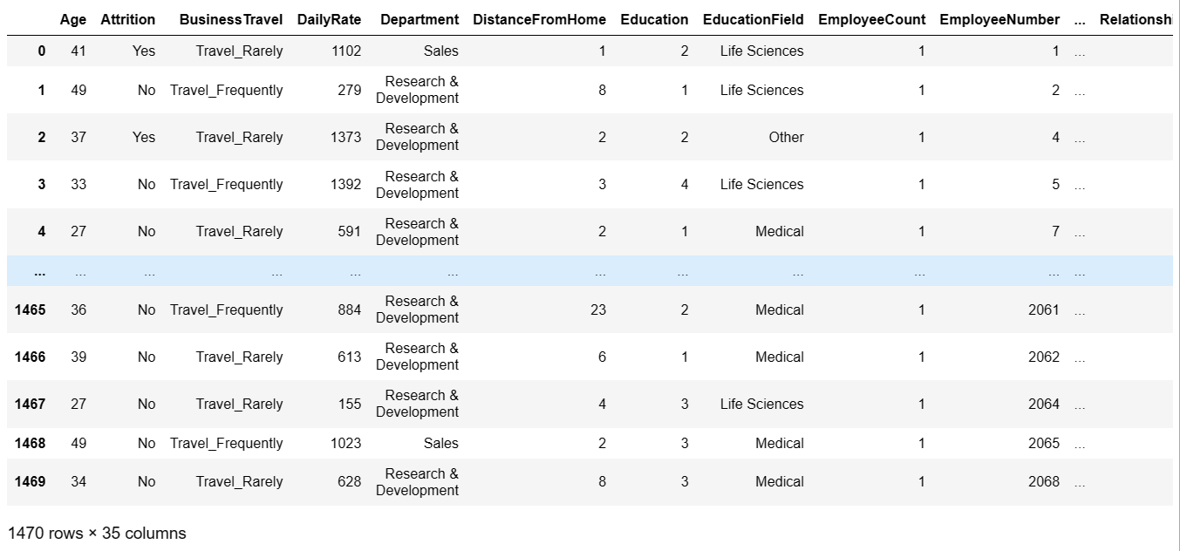
Raw Data
Insights : We have 1470 rows and 35 columns in the Raw data.

Slide 8
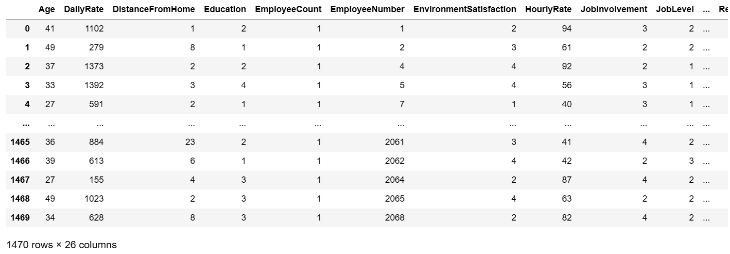
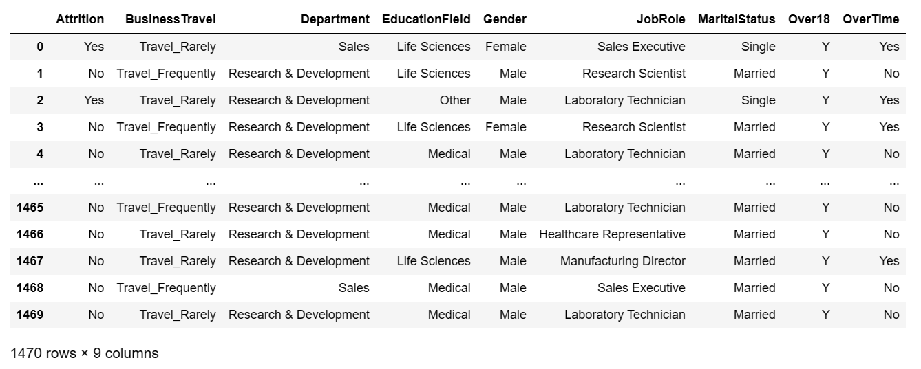
Numeric and Categorical Columns
There are only 26 columns Numerical Attributes in the dataset.
On the other hand we have 9 columns Categorical Attributes.

Slide 9
Data Visualization
Data visualization is the graphical representation of different pieces of information or data, using visual elements such as charts,graphs,or maps.
Data visualization tools provide the ability to see and understand data trends, outliers, and patterns in an easy to understand.

Slide 10
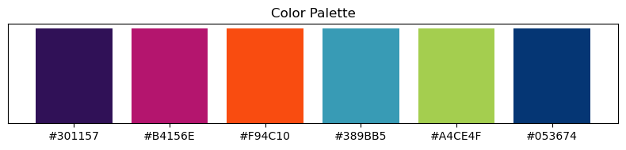
Visualization Colors Palette

Slide 11
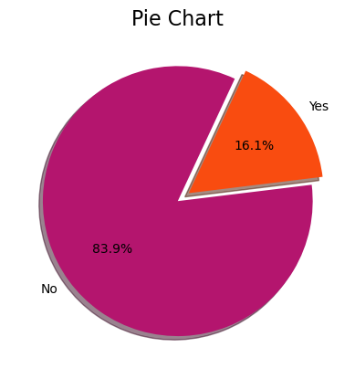
Visualizing Target Column
Attrition - Does the employee leave the organization
Target data class is show imbalance data between Attrition Yes are No
Here are 83.9% are NO means Yes Attrition and remaing 16.1% are YES means No Attrition

Slide 12
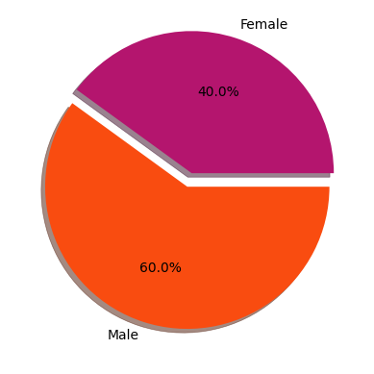
Males and Females in This Job
We can clearly see that the majority of the employees are males 60.0%

Slide 13
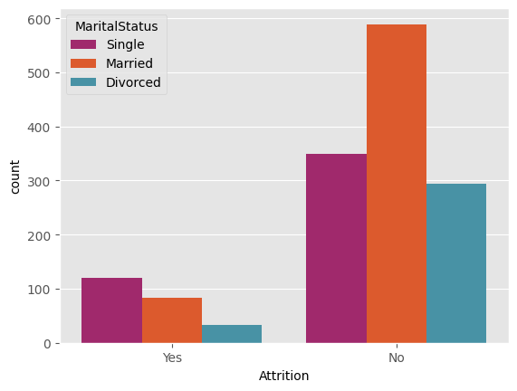
Relationship between marital status and attrition
We can clearly see that the Singles are more likely to attrition as they don't care as much for a stable static life as the married employees.

Slide 14
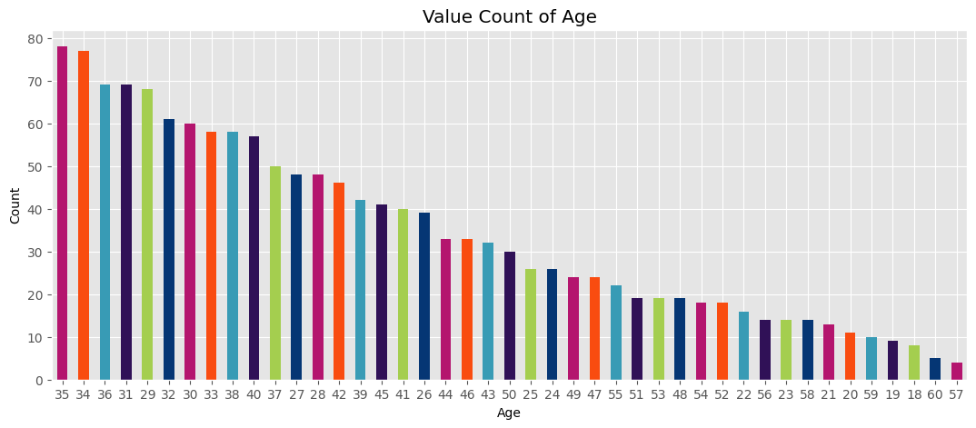
Most common Age
Insights : 35 is the most common age and least age 57

Slide 15
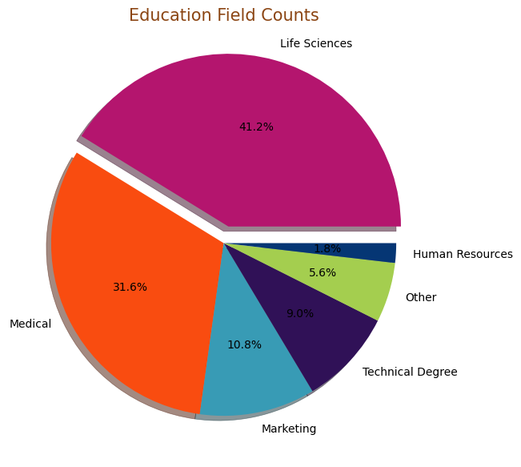
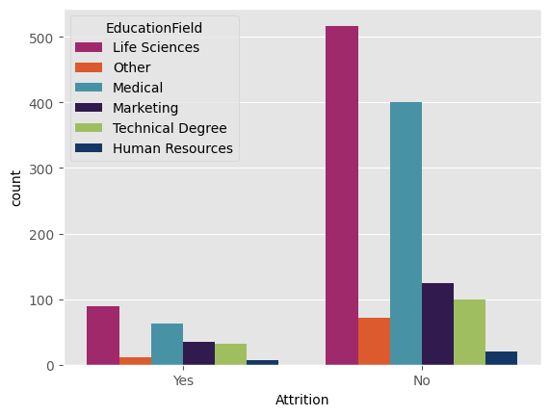
Employees by the Education Field
The majority of employee are life science educated.

Slide 16
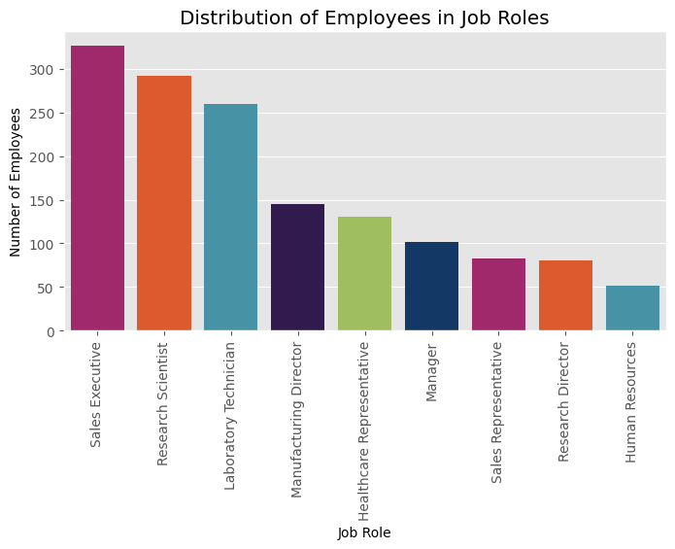
Employees in each Job role
The most common Job role is sales executive

Slide 17
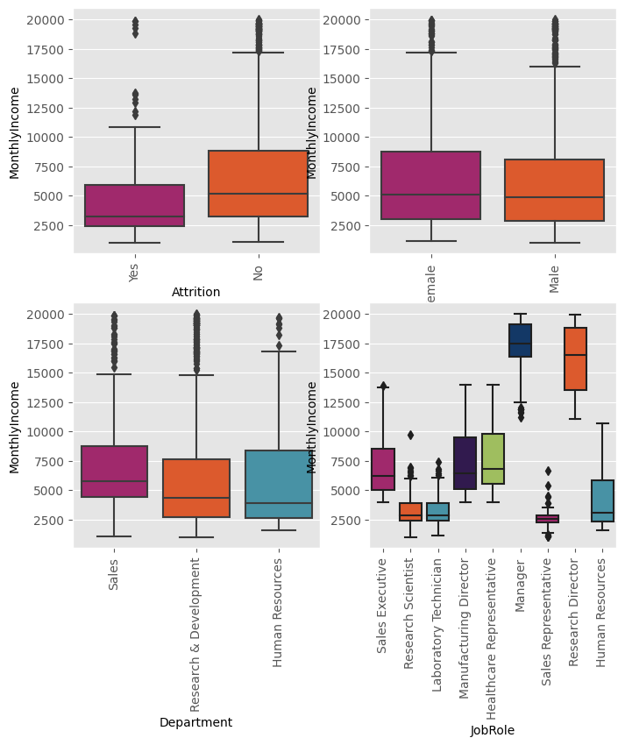
Box plots
The number of employees in the Sales department is significantly higher than in other departments.

Slide 18
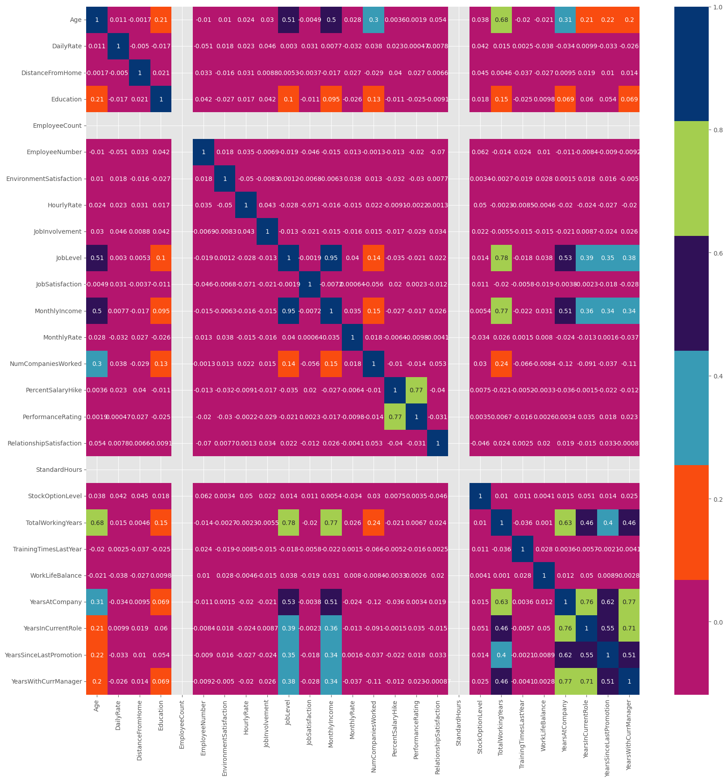
A heatmap for all the columns values

Slide 19
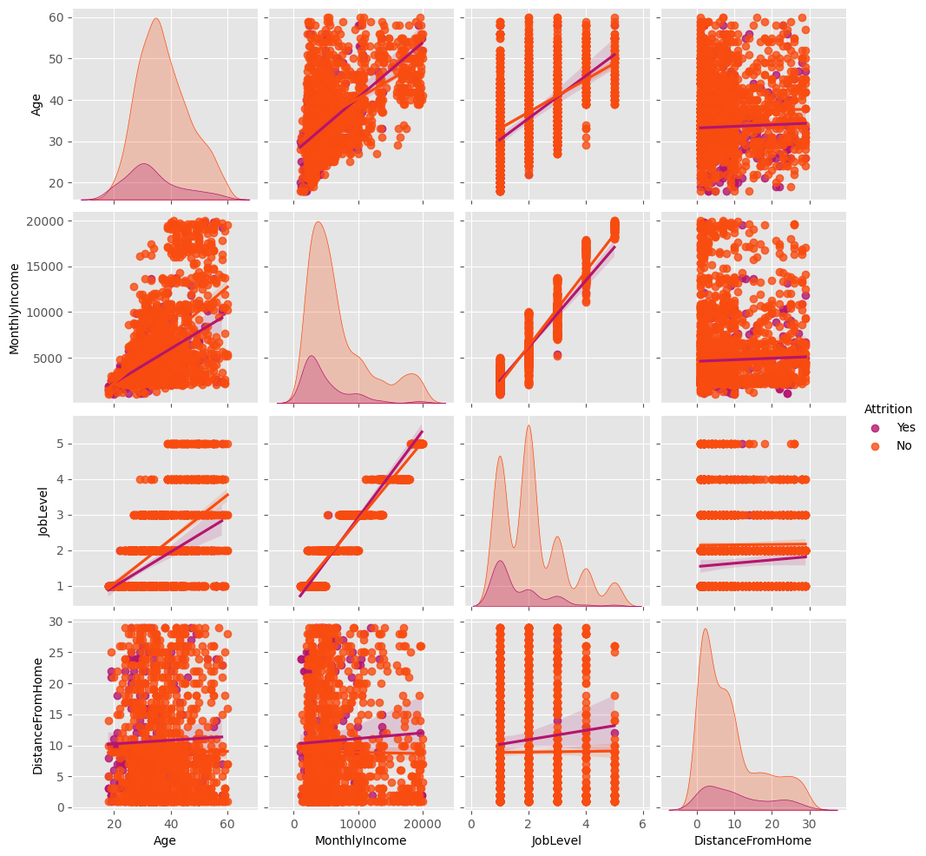
Pair Plot relationships in a dataset- 'Attrition', 'Age', 'MonthlyIncome', 'JobLevel', 'DistanceFromHome'

Slide 20
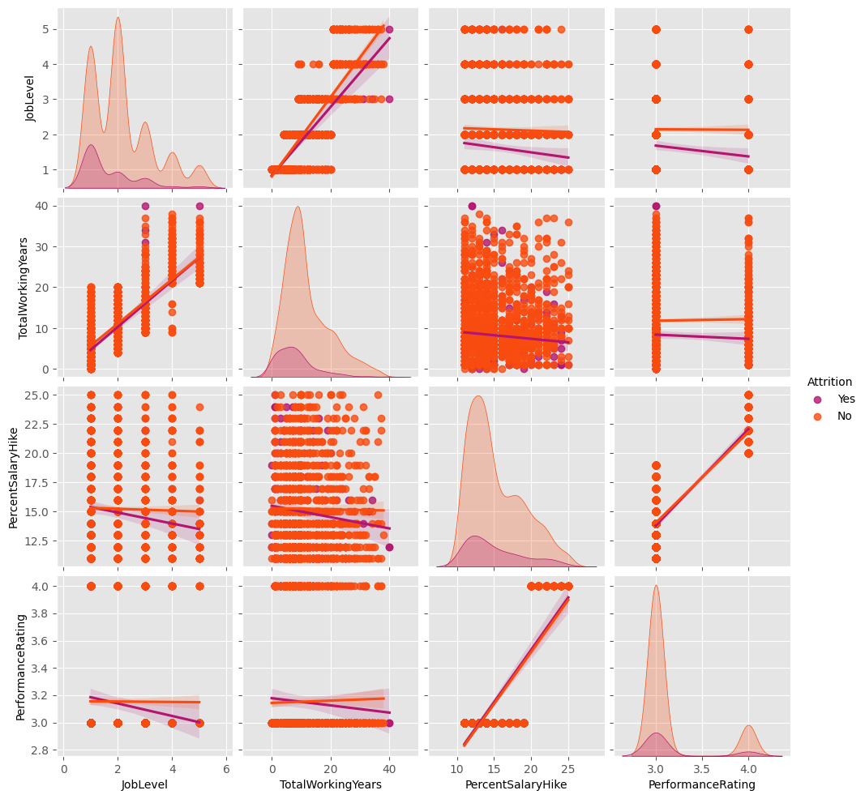
Pair Plot relationships in a dataset -'Attrition','JobLevel','TotalWorkingYears', 'PercentSalaryHike','PerformanceRating'

Slide 21
Data Preprocessing
Spliting The Data Into Train And Test :
The data is split into training and test sets with a 70/30 split.
The target column is encoded using label encoding
Column Transformer To Combine All The Pipeline To One Final Pipeline
OneHotEncoder With Minmaxscaler :
One-hot encoding is a technique for converting categorical data into numerical data.
It works by creating a new binary feature for each category in the categorical data
MinMaxScaler is a technique for scaling numerical data to a range of [0, 1]
This is useful for machine learning algorithms

Slide 22
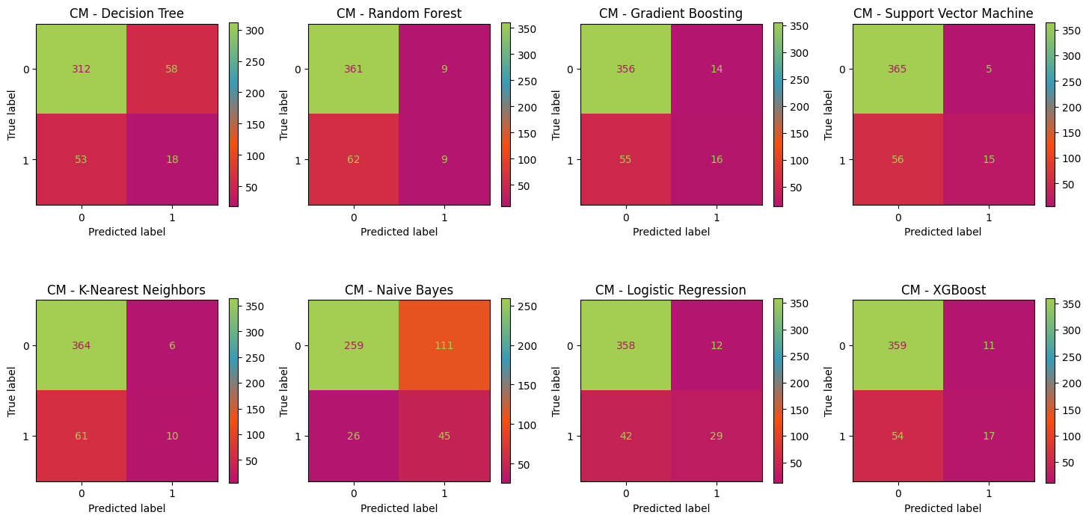
Data Modelling
Accuracy : OneHotEncoder With Minmaxscaler

Slide 23
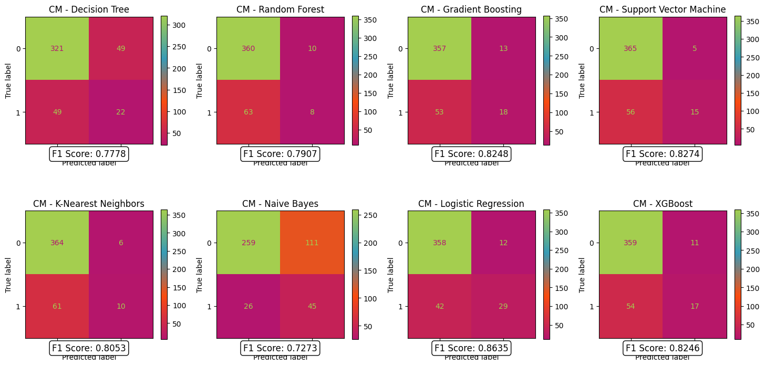
F1 Score : OneHotEncoder With Minmaxscaler

Slide 24
Conclusions :
The analysis is based on the available dataset and may not capture all possible factors influencing employee attrition.
There could be other unmeasured variables that play a role in attrition.

Slide 25


